Slide 1
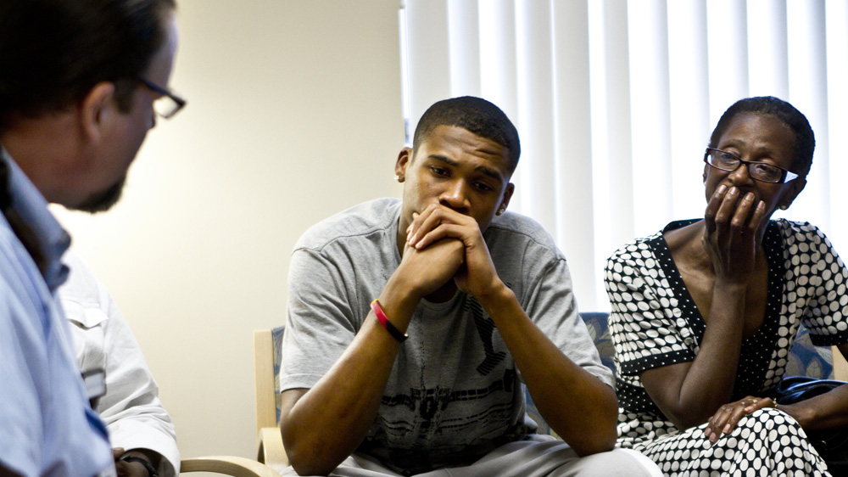
Collaborative Donation Discussions

Slide 2
Collaborative Donation Discussions:
THE BACKGROUND
Research has noted that next-of-kin are less likely to authorize donation when non-OPO personnel approach the family about donation:
  Participants said that when first approached by someone from the hospital (ie. physician, nurse) rather than the OPO, they questioned whether every effort had been made to save their loved one.
  Participants said they did not have enough time to consider their decision.
Some families who declined donation in such circumstances expressed “decision regret” following their loved ones’ death.
Sources: Transplantation, 2017; American Journal of Transplantation 2008, 2014; BMC Anesthesiology, 2014; Clinical Transplant, 2010; British Medical Journal, 2009

Slide 3
Collaborative Donation Discussions:
THE PROCESS
When organ donation is first discussed with OPO representatives.
Higher likelihood of authorization.
Lower likelihood of decision regret in the weeks that follow.
Successful donation programs implement collaborative processes at of end-of-life care.
OPO representatives are first to discuss organ donation options with family members.
Centers for Medicare and Medicaid Services (CMS) requirement
This practice is consistent CMS and has shown to facilitate an optimal donation request process.
Sources: Transplantation, 2017; American Journal of Transplantation 2008, 2014; BMC Anesthesiology, 2014; Clinical Transplant, 2010; British Medical Journal, 2009

Slide 4
Collaborative Donation Discussions:
THE RESULTS
REASSURED
Families felt reassured when healthcare providers explained the high degree of medical care and effort to save their loved one.
Families asked more questions and said they could process information better with more time between learning about death and learning about donation.
Improved rates of authorization when there was separation between notification and acceptance of death and request for donation.
Increased authorization rates with a collaborative approach by OPO coordinators and hospital care team.
UNDERSTANDING
IMPROVED RATES
INCREASED AUTHORIZATION
Sources: Transplantation, 2017; American Journal of Transplantation 2008, 2014; BMC Anesthesiology, 2014; Clinical Transplant, 2010; British Medical Journal, 2009

Slide 5
Sources (1/2)
Cornell, Danielle L. (2010) Family Initiated Discussions About Organ Donation at the Time of Death. Clinical Transplant 24(4), 493-499. https://www.ncbi.nlm.nih.gov/pmc/articles/PMC2888774/
de Groot, J. (2014). Intensive care staff, the donation request and relatives’ satisfaction with the decision: a focus group study. BMC Anesthesiology 14 (52). https://bmcanesthesiol.biomedcentral.com/articles/10.1186/1471-2253-14-52
  1 ICU in study – 228 patients reviewed
Ralph, A. (2014). Family Perspectives on Deceased Organ Donation: Thematic Synthesis of Qualitative Studies. American Journal of Transplantation 14(4), 923-935. https://onlinelibrary.wiley.com/doi/full/10.1111/ajt.12660
  1035 family members; 672 authorized donation, 244 no authorization

Slide 6
Sources (2/2)
Rodrigue, James R. (2008). The Instability of Organ Donation Decisions by Next-of-Kin and Factors that Predict It. American Journal of Transplantation 8(12), 2661-2667. https://www.ncbi.nlm.nih.gov/pmc/articles/PMC2588486/
  Study included 285 families, retrospective phone interviews and EMR review
Shemie, Sam D. (2017). End-of-Life Conversations with Families of Potential Organ Donors. Transplantation 101(5S), S17-S26. https://journals.lww.com/transplantjournal/FullText/2017/05001/End_of_Life_Conversations_With_Families_of.2.aspx
  146 cases reviewed
Simpkin, Arabella L. (2009). Modifiable factors influencing relatives’ decision to offer organ donation: systematic review. BMJ 338, b991. https://www.ncbi.nlm.nih.gov/pmc/articles/PMC2671586/
  9 trauma hospitals including 2 Pediatric. 420 cases reviewed

